Slide 1

Amazon Store Sales Dataset Analysis
A comprehensive business and analytical perspective on customer behavior, sales performance, and profit optimization opportunities

Slide 2

Amazon Store Sales Dataset
Business & Analytical Insights
Prepared by: Data Analyst
Transforming raw sales data into actionable business intelligence for strategic decision-making and revenue optimization

Slide 3

Project Objective
Exploratory Data Analysis
Customer Behavior Analysis
Perform comprehensive EDA on Amazon Store sales dataset to uncover hidden patterns and trends in customer purchasing behavior
Understand who buys, what they buy, and how they make purchasing decisions across different segments and regions
Performance Identification
Identify top-performing categories, regions, and customer segments to focus strategic initiatives and resource allocation
Profit Leakage Detection
Detect loss-making sales, high return rates, and COD dominance that may be impacting overall profitability and operational efficiency
Actionable Recommendations
Provide data-driven recommendations to improve sales performance, enhance profitability, and optimize business operations

Slide 4
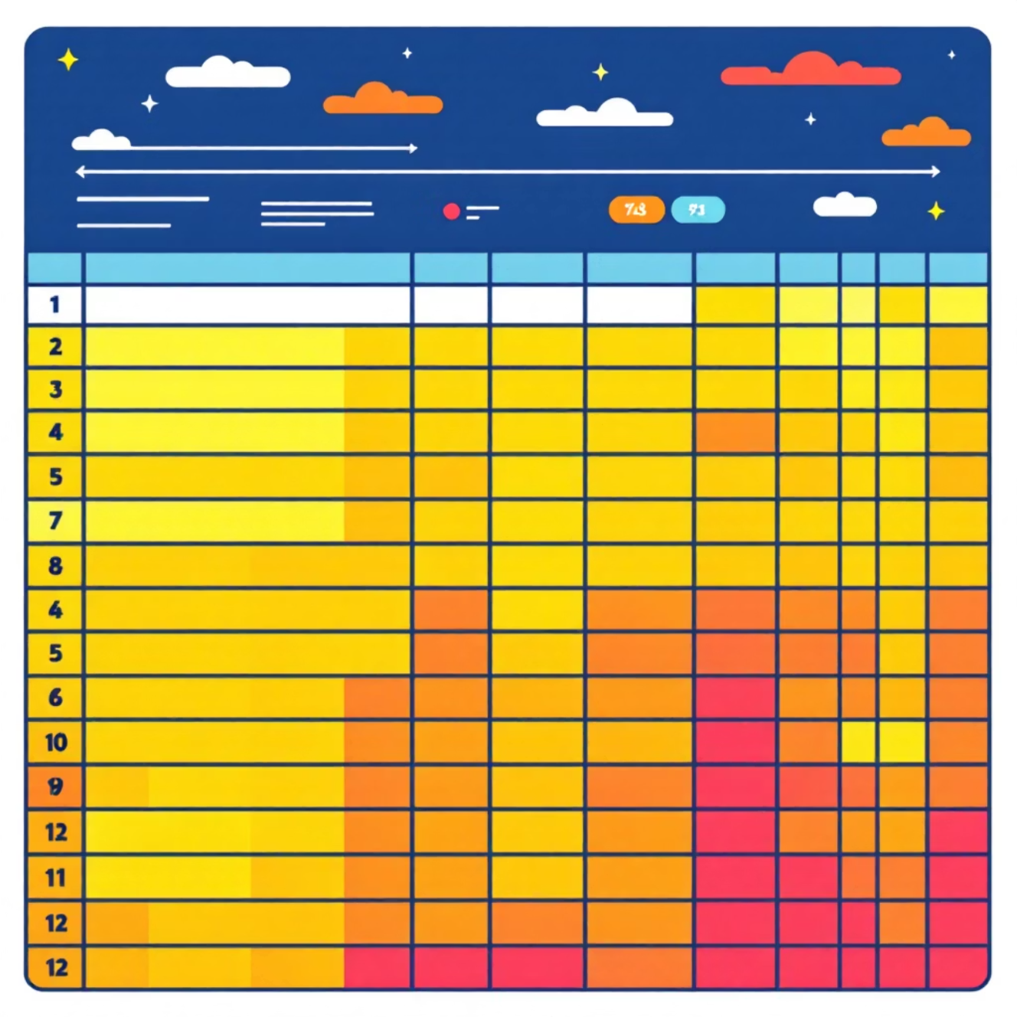

Dataset Overview
5,901
21
Total Transactions
Data Features
Complete sales records analyzed
Comprehensive variables captured
0
Missing Values
Clean dataset ready for analysis
Key Variable Categories
Customer Dimension: ID, Name, Segment, Geography
Order Dimension: Order ID, Dates, Ship Mode, Payment Mode
Product Dimension: Category, Sub-Category, Product Name
Performance Metrics: Sales, Quantity, Profit, Returns
Data Quality Excellence: No missing values detected - dataset is immediately ready for comprehensive analysis without preprocessing requirements

Slide 5







Customer Insights
Corporate Segment
~31% of sales
Significant B2B contributor with bulk purchase potential
Consumer Segment
~51% of sales
Primary revenue driver requiring focused marketing investment
Home Office Segment
~18% of sales
Growing remote work market segment
Customer Loyalty Indicators
773 unique customers generated 5,901 transactions, indicating strong repeat purchase behavior. Some loyal customers placed 25+ orders, demonstrating exceptional brand loyalty and lifetime value potential.
"Consumers are the largest revenue drivers → focus marketing here. Corporate and Home Office are smaller but steady contributors."

Slide 6
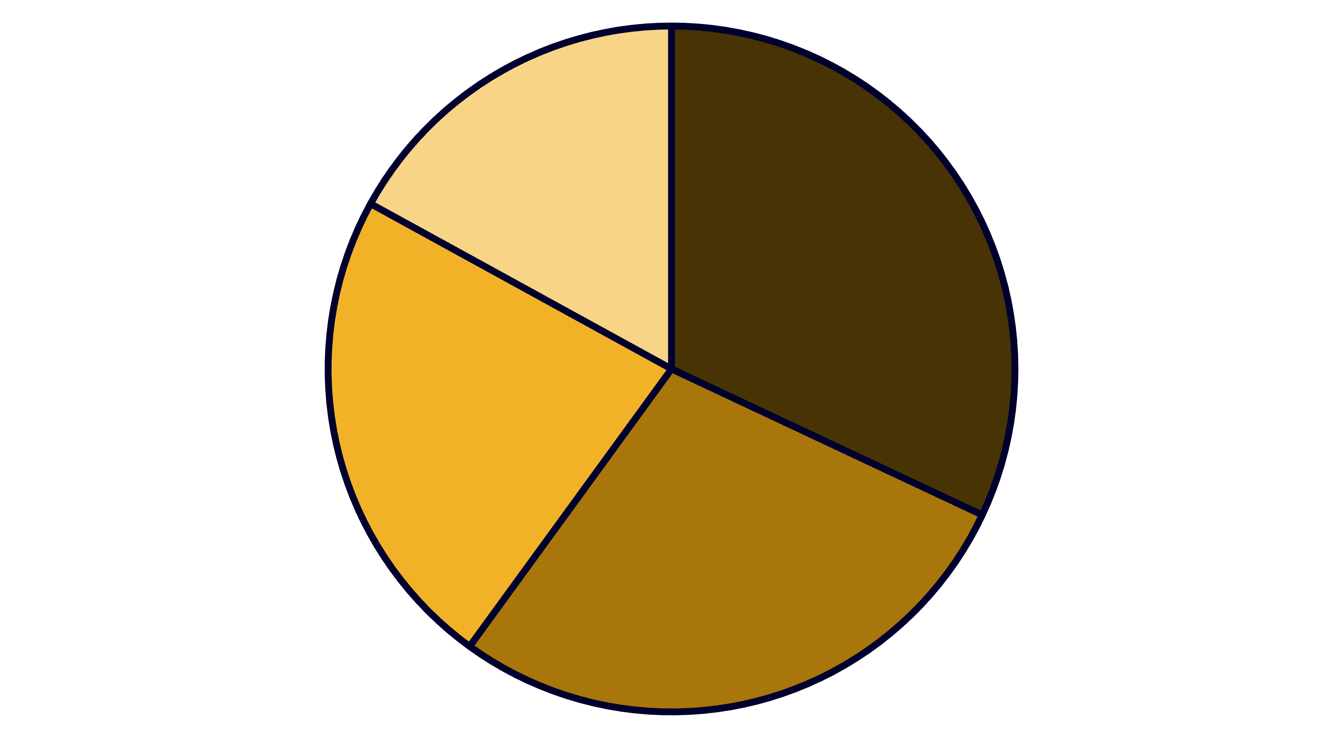
Geographic Performance Analysis
Market Coverage
49 States and 452 Cities across the United States, demonstrating comprehensive national market penetration
Top Performing States
California, New York, and Texas lead in sales volume, representing key strategic markets
West
East
Central
South
Strategic Insight: California & New York are key markets requiring inventory focus & promotions. South region is underperforming → opportunity to expand presence and capture untapped market potential.

Slide 7




Product Category Performance
60%
25%
15%
Office Supplies
Technology
Furniture
Highest transaction volume
Premium product category
High-value transactions
Sub-Category Analysis (17 Total Categories)
Best-Selling Sub-Categories
Binders: High-frequency office essential
Paper: Consistent demand driver
Phones: Technology category leader
Chairs: Furniture category standout
Niche High-Value Products
Copiers: Low frequency, high transaction value
Machines: Specialized equipment sales
"Office Supplies → High order count but relatively lower profit. Technology → Fewer orders but higher average profit margin. Furniture → Expensive but profit inconsistent due to heavy discounts."

Slide 8

Sales & Profitability Analysis
$265
$30
11%
Average Sales
Average Profit
Profit Margin
Per order transaction value
Per order profit margin
Overall profitability ratio
Performance Range Analysis
Metric
Minimum
Maximum
Sales Value
$0.80
$9,099
Profit/Loss
-$6,599 (loss)
+$8,399 (profit)
Critical Issue Identified: High sales ≠ High profit → discounting or shipping cost issues creating profit leakage
Analyst Insight: Large variance in profit indicates poor discount control. Need to analyze which sub-categories generate losses and implement pricing optimization strategies.

Slide 9


Quantity & Returns Impact
3.8
Average Units
Per order quantity sold
5%
Return Rate
Orders returned by customers
Quantity Distribution Analysis
Order quantities range from 1 to 14 units per transaction, with an average of 3.8 units indicating moderate bulk purchasing behavior. The relatively low average suggests opportunities for upselling and cross-selling initiatives.
Returns Challenge
Approximately 5% of orders are returned, which significantly erodes profit margins. This return rate likely stems from:
Product quality issues
Delivery delays and damage
Mismatch between customer expectations and reality
Profit Impact: Returns erode profit margins through processing costs, restocking fees, and lost sales opportunities
Inadequate product descriptions or images

Slide 10





Shipping & Payment Mode Analysis
Shipping Preferences
Payment Method Distribution
58%
42%
Standard Class
Cash on Delivery
Most popular shipping option
Largest payment share
42%
58%
Premium Options
Digital Payments
Second Class, First Class, Same Day
Online & Bank Cards
1
Cost-Conscious Customers
Standard Class dominance shows customers prefer low-cost delivery options, indicating price sensitivity in shipping decisions
2
COD Risk Management
High COD share (42%) increases operational risks through cash handling complexities and higher return probabilities
3
Digital Payment Opportunity
Encourage digital payments with cashback/discounts to reduce operational costs and improve cash flow management
Strategic Recommendation: Implement digital payment incentives and optimize shipping cost structures to improve operational efficiency while maintaining customer satisfaction.

